Slide 1



IMdb movies data analysis
Sabira Pashayeva

Slide 2

How movie studios like Marvel and Warner Bros. churn out hit after hit, with only the occasional flop….

Slide 3


Spoiler alert: it’s not by chance, it’s thanks to advanced data analytics in entertainment industry.
?

Slide 4


IMDb is the world's most popular and authoritative source for information on movies, TV shows, and celebrities. Products and services to help fans discover and decide what to watch and where to watch it include: the IMDb website for desktop and mobile devices; apps for iOS and Android; and, X-Ray on Prime Video.

Slide 5




Tech Stack Used

Slide 6

Dataset Overview
The dataset provided is related to IMDB Movies and contains records of movies from a number of years.
The Dataset details are: - Number of Data-Points: 368300 - Number of Features: 14 - Column Details: 1. movie_id
2. movie_title: Name of the movie 3.year : Release year of movie 4. certificate: 5. runtime: Duration of the movie 6. genre: Genres of movie 7. rating: Rating of the movie 8. description: Plot summary of movie 9. director: Name of the directors 10. director_id: ID of the directors 11. star: Name of the actors 12. star_id: ID of the stars 13. votes: Number of users voted for the movie 14. gross(in $): Gross collection of the movie

Slide 7
Genre prediction of movies
Stages of process
5
4
3
2
Validation and Iteration
1
Modeling and Analysis
Feature Engineering
EDA
Data cleaning

Slide 8
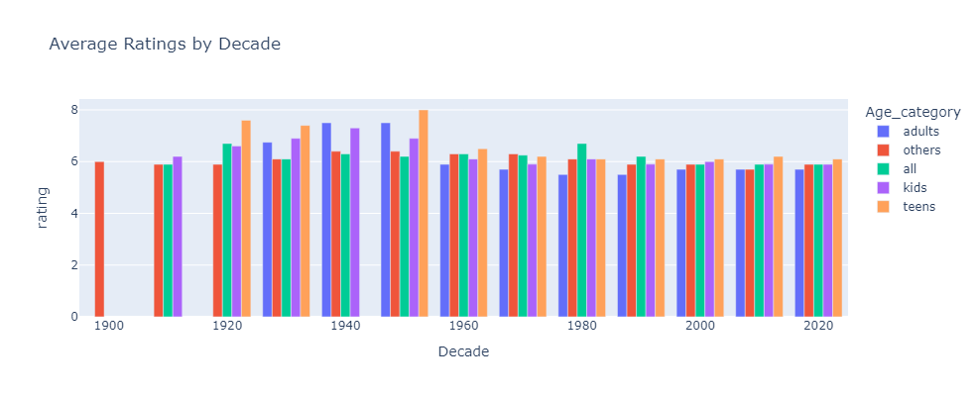
Average ratings by Decade
The movies aimed at teens tend to get more votes in last decades

Slide 9
Ratings by Decade and Age category
1970-2000
The movies aimed at all ages was more popular
1960-1970
2000-2010
The movies aimed at teens and all was popular
Adult movies ratings got higher
1900-1960
2000-2024
Teen movies was more popular
Teen movies got more popularity again

Slide 10
Movies aimed at teenagers in the 1950s often received high ratings for several reasons, reflecting the cultural, social, and economic context of the time.
Emergence of the Teenager as a Distinct Demographic
Rise of Rock 'n' Roll and Pop Culture
Drive-In Theaters
Economic Prosperity
Star Power
Innovative Film Marketing

Slide 11
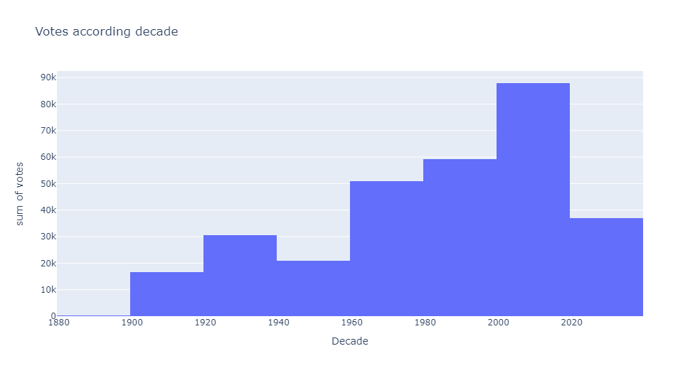
The number of given votes by Decade
Movies released in between 2000-2010 got more votes:
1
Increased Internet Usage
2
Nostalgia Factor
3
Proliferation of Online Communities
4
Longevity of Popular Films

Slide 12
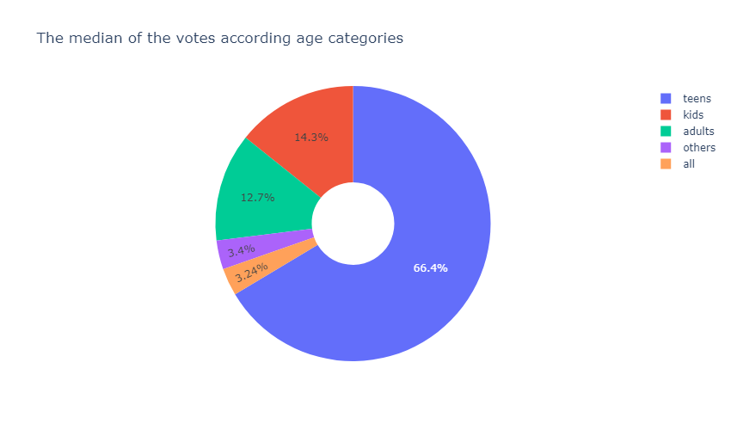
The median of the given votes by Age categories
Teen movies get the most of the voters too!
Teens!

Slide 13
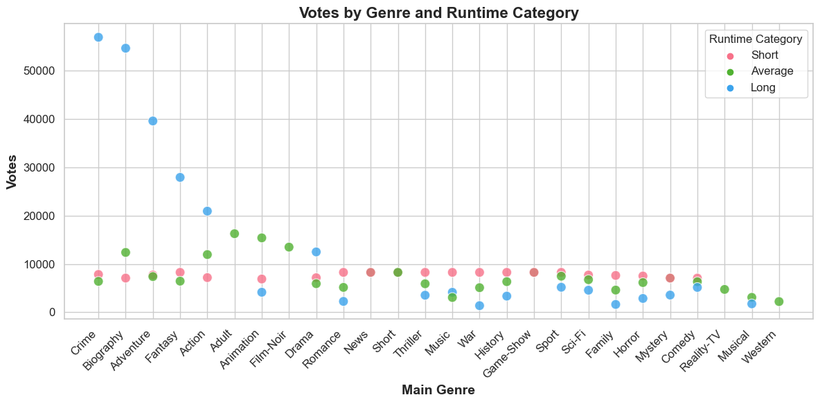
Votes by Genre and Runtime category

Slide 14
Film industry Marketing Infographics
Long
Short
Crime, Biography, Adventure, Fantasy, Action, Drama get more votes
Music, War, Sport, Sci-fi, Horror, Comedy
Voters tend to vote

Slide 15
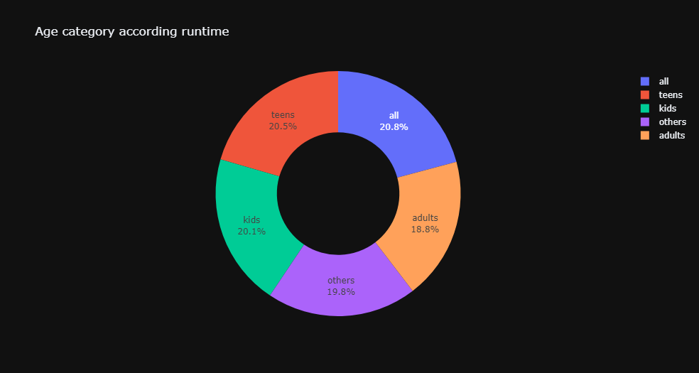
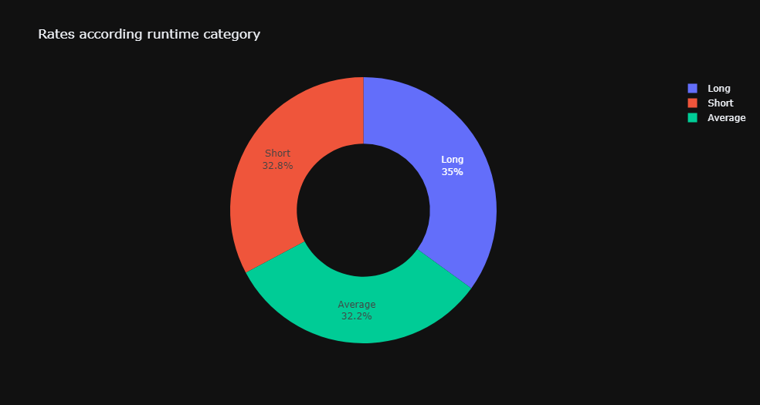
Rates by age category and runtime
Long !

Slide 16
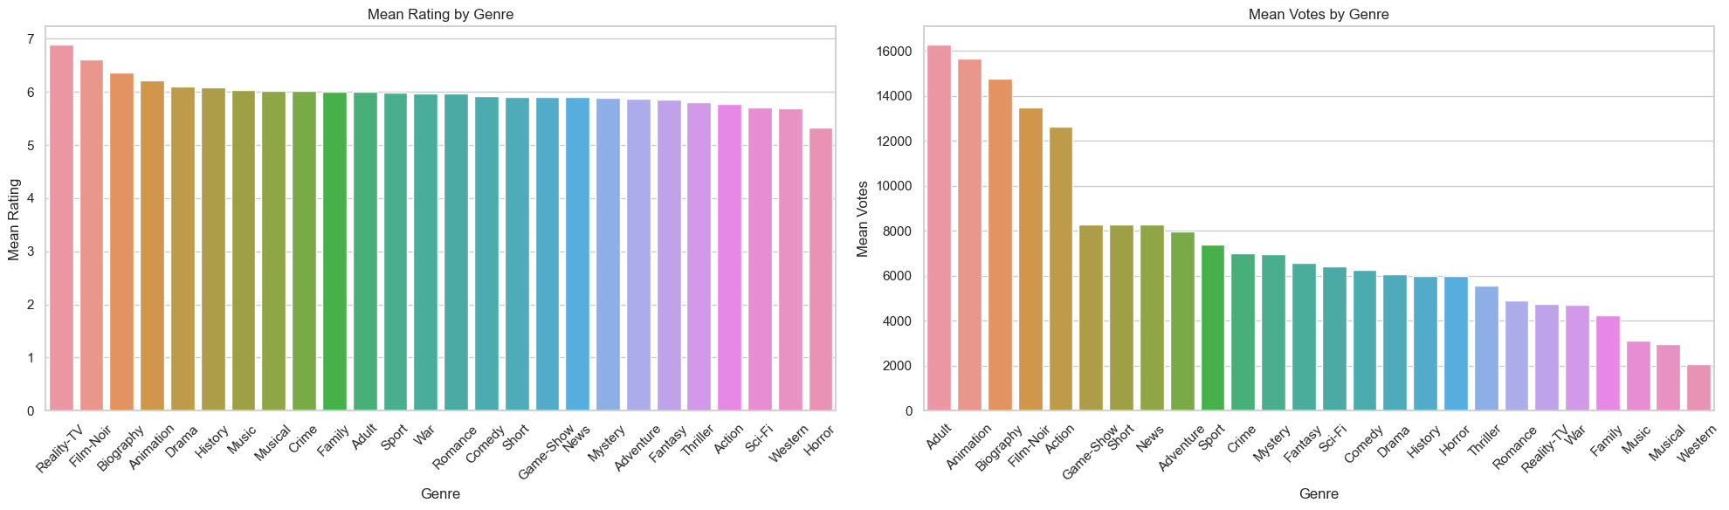
Reality shows tend to attract higher ratings, while adult movies receive more votes.

Slide 17
Why do reality shows receive higher ratings even though they are not the genre that gets the most votes?
Fan loyalty and regular viewership
Broad appeal
1
2
3
4
Emotional connection and relatability

Slide 18
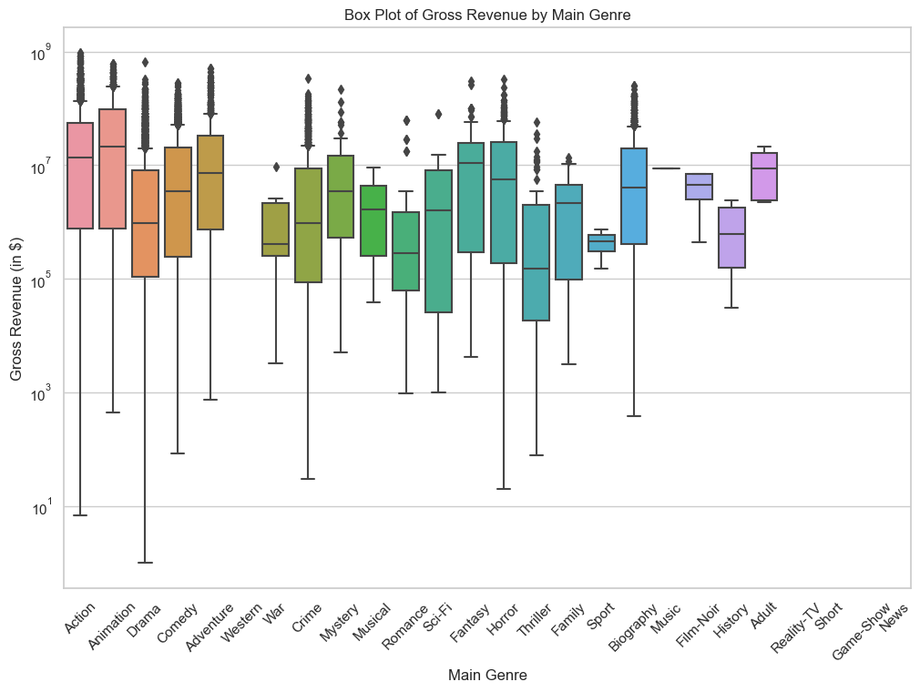

Slide 19
Top 5 Total Gross Earnings by Genre
1
Action
1.6M $
2
3
4
5
Animation
Comedy
Drama
Adventure
0.8M $
0.5M $
0.35M $
0.30M

Slide 20
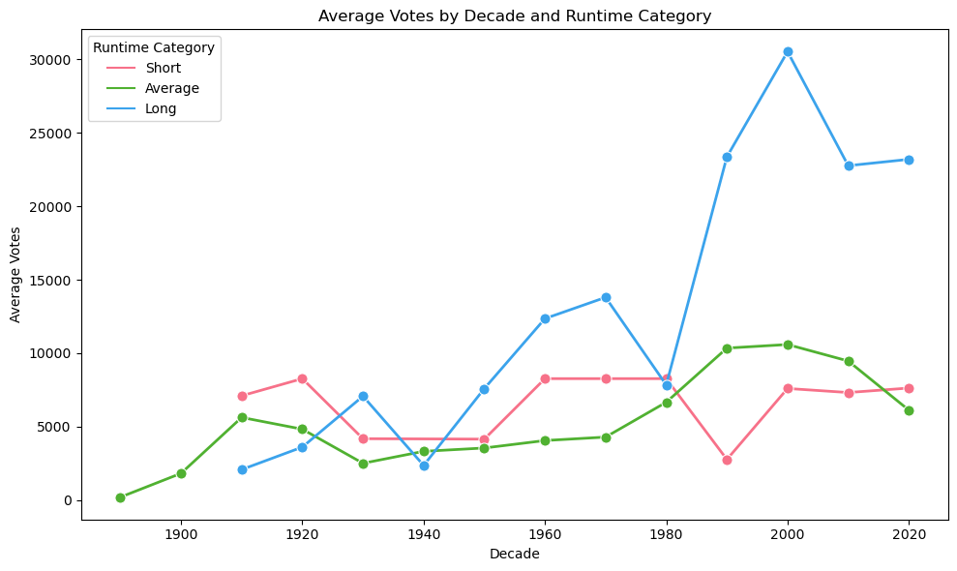
Filmmaking Process Infographics
Post-production

Slide 21
Why the long movies released in 2000’s got more votes unlike 1940’s ?
Accessibilty
Cultural Shifts
Marketing and Promotion
Prestige and Awards

Slide 22
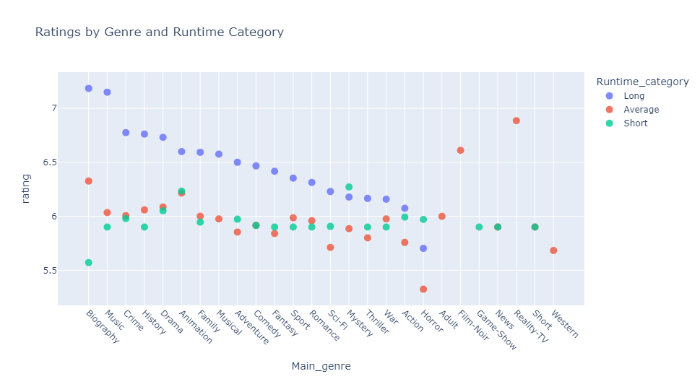
Ratings by Genre and Runtime

Slide 23

Horror and mystery films tend to receive higher ratings when their runtime is shorter:
1
4
Pacing and Plot Development
Audience Expectations and Engagement
2
3
Genre Conventions
Quality vs Quantity

Slide 24
Rating Battles by Genre
1
Team 1
Biography, Action, Drama, Adventure, Romance
2
Team 2
Musical, Sci-fi, Mystery, News, Adult, Western

Slide 25
Top 10 movies with the highest Rating
The Puzzling Secret
The Universal Quest
Time's Paradox
Journey of Eternity
Invisible Hacker
Tahanan (Home)
Don Cutting 2
She Inherited Danger
An Example of Teenage Boredom: The Movie
Love Mein

Slide 26
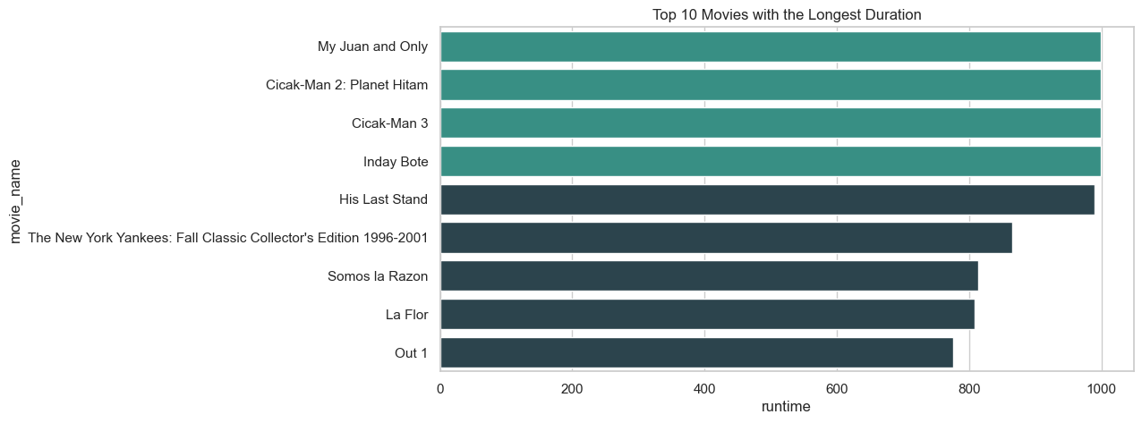
Top 10 movies with the Longest Runtime

Slide 27
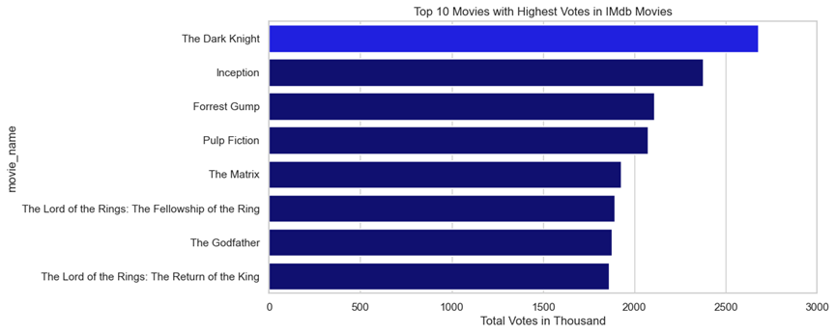
Top 10 Movies with Highest votes in IMdb

Slide 28




Top Directors with max rating
1
Juwel Chowdhury
2
Frank Gilbert
3
Krunal Rane
4
Nicholas Barber

Slide 29
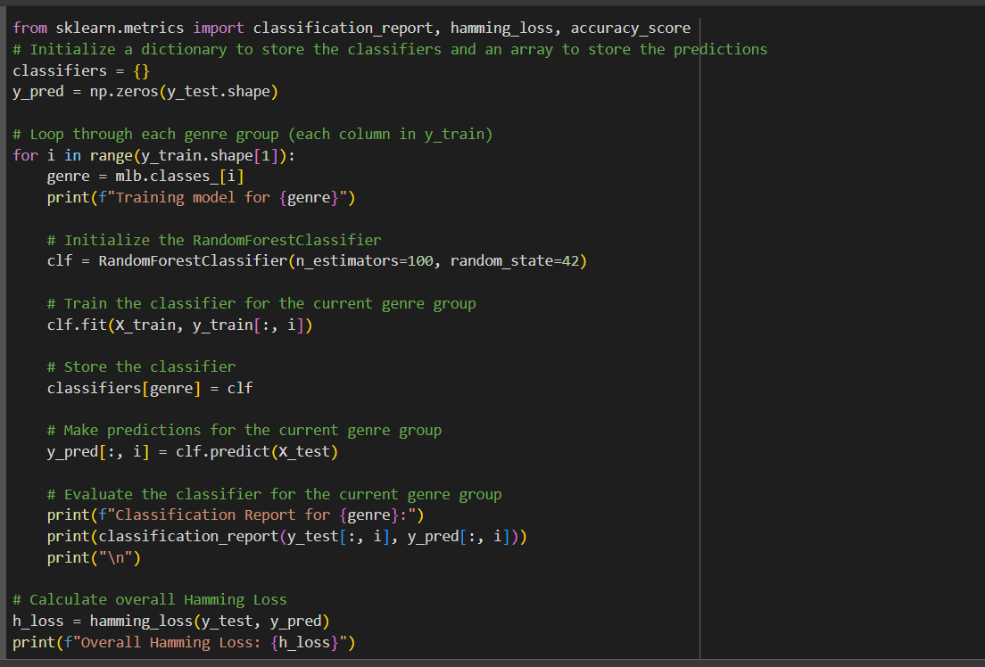
Modelling
Gini Impurity for Action/Adventure/Sci-Fi: 0.188827207256484
Gini Impurity for Animation/Fantasy: 0.14821773219937667
Gini Impurity for Biography/History/War: 0.14748358352718985
Gini Impurity for Comedy/Family: 0.1776093624032694
Gini Impurity for Crime/Thriller/Mystery/Film-Noir: 0.19213039067866908
Gini Impurity for Drama/Romance: 0.19233814601809096
Gini Impurity for Horror/Short: 0.16739734026342915
Gini Impurity for Music/Musical: 0.11693845081776531 Gini Impurity for Others: 0.1117060988533634
Overall AUC score: 0.6069782769104252

Slide 30
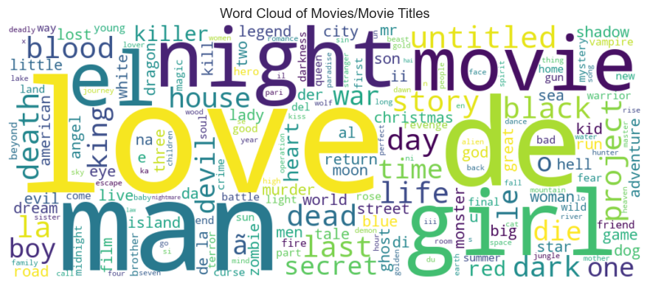
Word Cloud of Movie Titles

Slide 31


